Slide 1


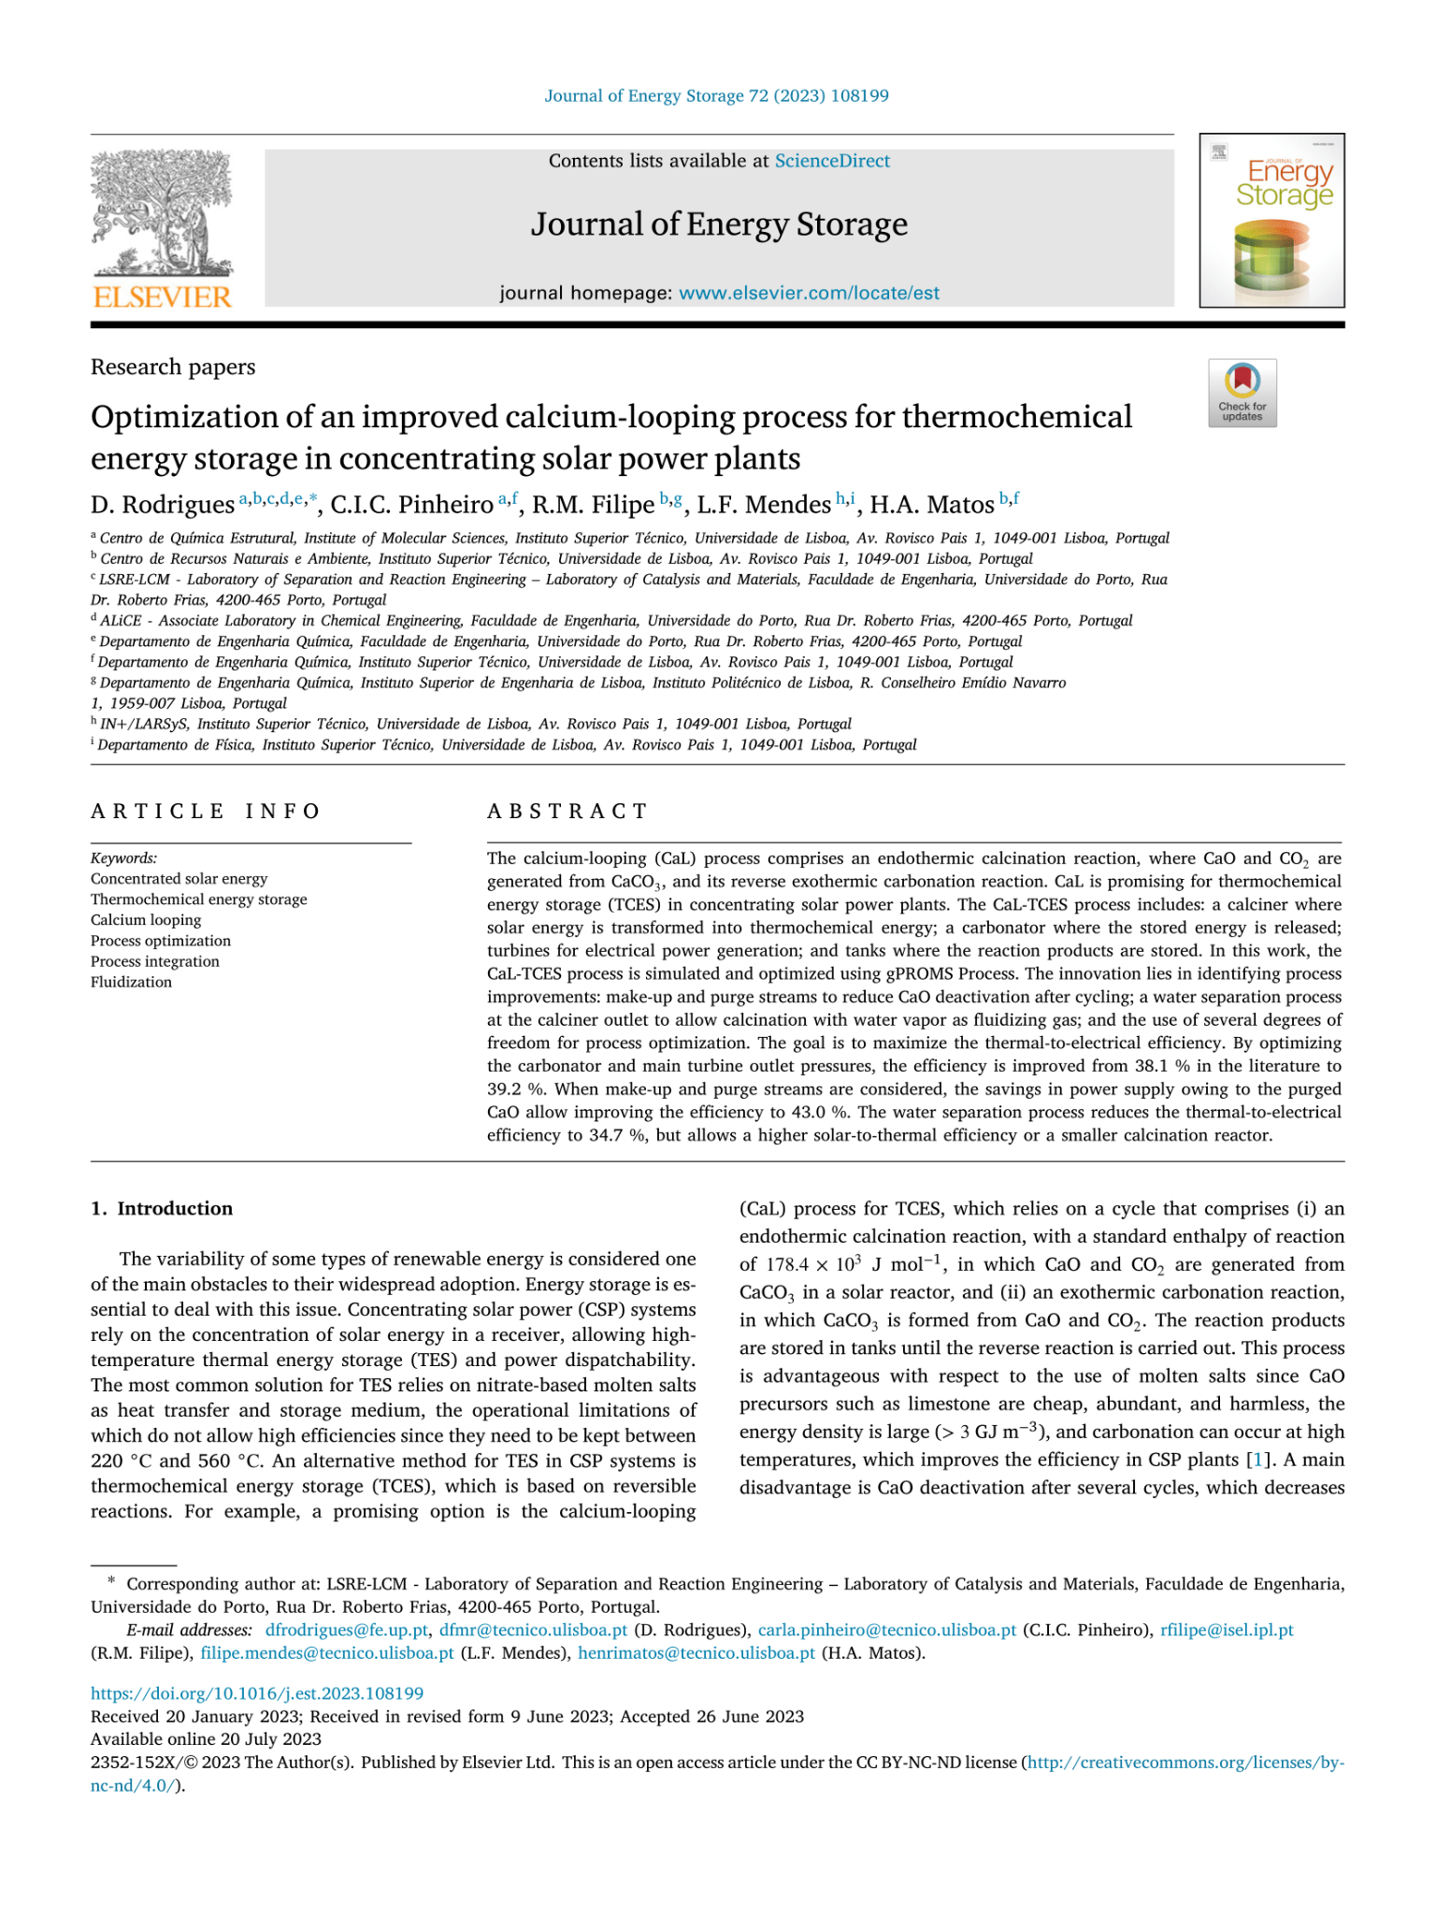
Optimization of an improved calcium-looping process for thermochemical energy storage in concentrating solar power plants
Slide No : 1
DATE : 05/09/2023
Presented By : Mrityunjay Sharma 210107054 Dnyanesh Bhole 210107019 Rohit Chalak 210107073 Govind Madhav Vyas 210107031

Slide 2
CONTENTS
Slide No : 2
INTRODUCTION
2. PROCESS MODELLING AND OPTIMISATION
3. RESULTS AND DISCUSSION
4. CONCLUSION

Slide 3
INTRODUCTION
Slide No : 3
BACKGROUND
The research aims to optimize the Calcium-Looping (CaL) process for thermochemical energy storage in concentrating solar power plants.
The CaL-TCES process proposed by Ortiz et al. is used as a benchmark and starting point for the simulation and optimization study.
The research introduces three innovative aspects: optimization of key variables, consideration of make-up and purge streams, and a proposed water separation process.

Slide 4
Slide No : 4
INTRODUCTION: Literature Comparison & Gaps
COMPARISON | GAPS
Maximizing the efficiency of carbonation and maintaining optimal outlet pressures for the main turbine, all without the need for purging or a water separation process. | The oversight of incorporating makeup and purge streams has led to missed opportunities for enhanced efficiency.
Taking into account the calcination process in the presence of water vapor while optimizing the fraction of solids purge. | Failed to explore the tradeoff between thermal-to-electrical and solar-to-thermal efficiency due to the absence of a detailed heat integration analysis.
Suggesting a method for separating water in order to utilize water vapor in the solar calcination process. | Overlooked the impact of enhanced residual conversion of a CaCO3/CaO mixture on overall efficiency.

Slide 5
GOALS & OBJECTIVES
Slide No : 5
Enhancing thermal-to-electrical efficiency through the optimization of carbonator and main turbine outlet pressures.
Investigating the influence of different solids purge split fractions on the efficiency of the CaL-TCES process.
Examining the balance between maximizing thermal-to-electrical efficiency and solar-to-thermal efficiency in the CaL-TCES process.

Slide 6
Slide No : 6
Process Modelling & Optimization
Description
This process uses sunlight to heat a mixture of substances, turning one of them into another and releasing a gas called CO2. This CO2 is then used to make hot air and steam.
When there's sunlight, the CO2 is squeezed and stored at high pressure. When there's no sunlight, this stored CO2 is used to power a special machine.
One part of the process works all the time, changing one substance into another. It also warms up the CO2 used by the machine and some of the CO2 coming out of it. The solid stuff that comes out of this part is used to heat up more CO2.
The whole process is explained in detail in gPROMS Process software. The part that changes substances works non-stop, while the part that uses sunlight only works when there's sunlight.

Slide 7
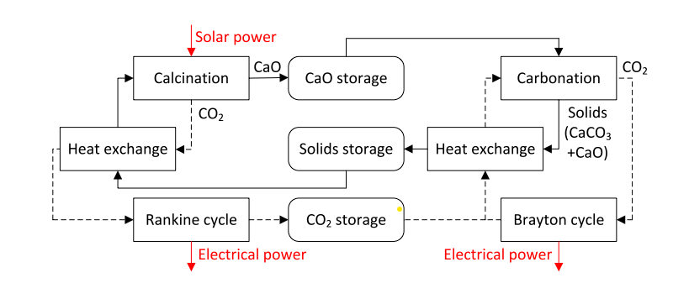
Slide No : 7
Schematic Diagram of Process

Slide 8
Description of the water separation process
Slide No : 8
No More Pure CO2: Instead of using only CO2, the process now mixes in water vapor for better efficiency.
Separation Goal: It splits the gas from the reactor into two parts: one with lots of water to recycle and one with lots of CO2 for backup.
Efficient Separation: This is done using stages and compressors to save energy.
Heating Step: Finally, both streams are heated to 900°C with the hot reactor gas for recycling water and using CO2 efficiently.

Slide 9
Optimization
Slide No : 9
Optimization Goal: The study focuses on maximizing the thermal-to-electrical efficiency of the CaL-TCES process, addressing constraints and obtaining a more efficient process.
Key Improvements: It introduces improvements compared to prior research by optimizing carbonator and turbine pressures, considering make-up and purge streams, and proposing a water separation process for better efficiency.
Decision Variables: The study treats carbonator and turbine pressures, make-up and purge streams, and compressor pressure ratios as decision variables, optimizing them to minimize power consumption and enhance overall efficiency.

Slide 10
Process Configurations
Slide No : 10
Pressure Optimization: Focuses on optimizing carbonator and turbine pressures without purge or water separation, assuming 15% residual conversion in the carbonator and CO2 in the calciner.
Solids Purge Variation: Introduces variable solids purge fraction (𝑓𝑝) from 0 to 1 while optimizing carbonator and turbine pressures, still using CO2 in the calciner.
Water Vapor Calcination: Explores calcination with water vapor, maintaining the optimal 𝑓𝑝 from Case 2, and considering the efficiency impact of a water separation process.

Slide 11
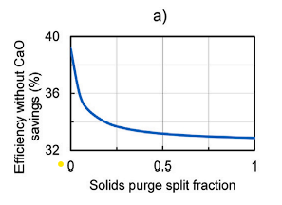
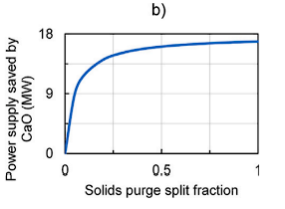
Result and Discussions
Slide No : 11
Optimization of the carbonator and main turbine outlet pressures:-
Changing carbonator pressures from 3 to 1.485 bar and turbine pressures from 1 to 0.293 bar significantly boosts efficiency of the CaL-TCES process i.e 38.1% to 39.2%. This depicts the importance of optimization of decision variables to enhance efficiency.

Slide 12
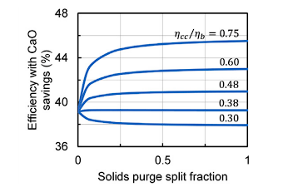
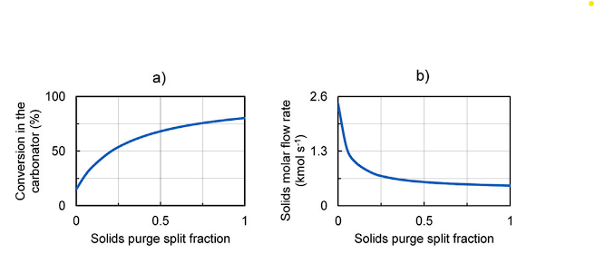
Effect of the solids purge split fraction
Slide No : 12
Increasing solids purge (𝑓𝑝) in the CaL-TCES
process reduces efficiency but saves power.
The ideal 𝑓𝑝 value depends on the efficiency ratio,
, with 43% efficiency achievable in the best case.
As 𝑓𝑝 rises, carbonator conversion increases
while solids flow decreases due to more CaCO3
turning into CaO.

Slide 13
Effect of the water separation process
Slide No : 13
Using water vapor in calcination has a smaller effect on efficiency compared to increasing solids purge (𝑓𝑝).
Even with water vapor, the best choice is 𝑓𝑝 = 1, giving an efficiency of 43%. But there's a tradeoff between maximizing thermal-electrical efficiency and solar-thermal efficiency.
The water separation process consumes power, reducing efficiency from 43.0% to 34.7%. Calcination at 800°C has minor effects but some benefits.
Water vapor generally improves the process due to lower temperatures, despite increased power consumption in water separation.

Slide 14
CONCLUSION
Slide No : 14
This study aims to enhance the efficiency of a calcium looping process used for storing solar energy as thermochemical energy. The process involves a solar calciner, carbonator, turbines, and heat integration.
Key innovations include adding streams to improve carbonator efficiency and a water separation process for using water vapor in the calciner.
Optimizing pressures boosts efficiency from 38.1% to 39.2%. With additional streams, efficiency ranges from 32.9% to 43.0%, improving if certain efficiency ratios are met.
A water separation process reduces efficiency to 34.7%, slightly impacted when lowering calcination temperature to 800°C.
Future work will consider energy for transporting materials, variable solar input, integrating with cement production, and alternative configurations.

Slide 15

Slide No : 15

